Slide 1
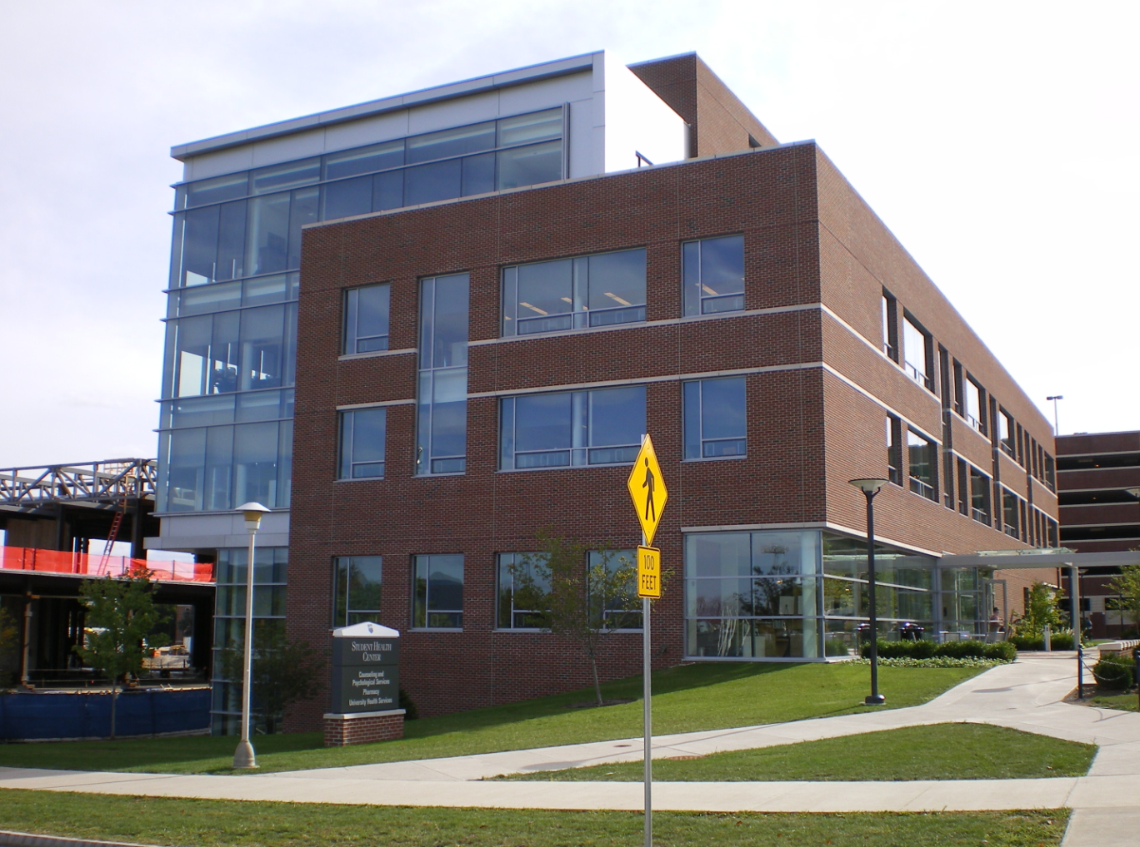
Student Health Center
Jacob Brambley - AE (structural option)

Slide 2
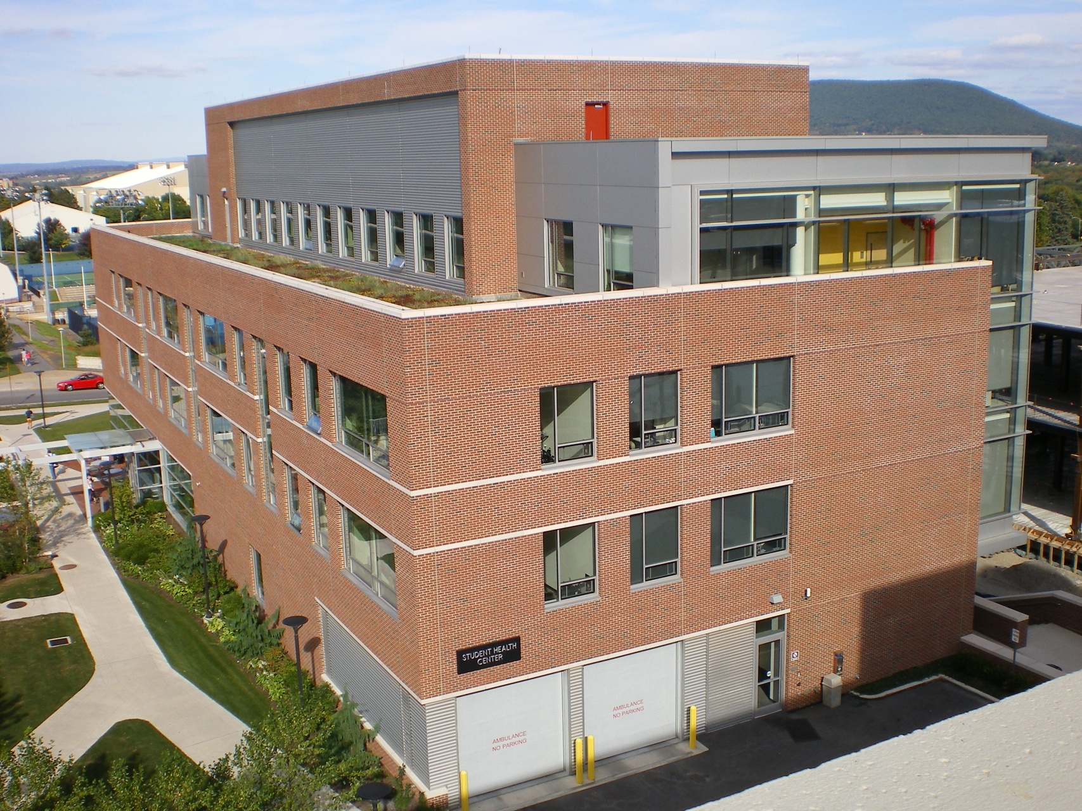
Student Health Center
(Current Building)
Location : University Park, PA
Size: 64,000 SF – 5 stories
Use: Offices, pharmacy, exam rooms
Architecture: Brick facade accented with stone bands; large curtain wall
Structure: Steel w/ slab on deck floor

Slide 3
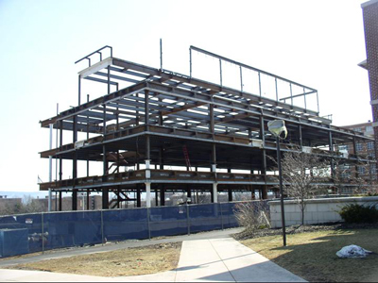
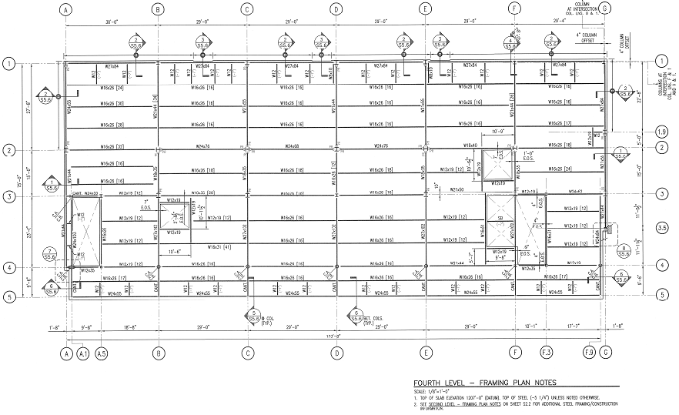
Student Health Center
(Current Building)
Lateral Force Resisting System
A
B
C
D
E
F
G
2

Slide 4
Goals
Examine the design effects of changing overall building structure including cost and schedule analysis
Use computer programs to aid in design of building components
Design shading system to remedy current problems

Slide 5
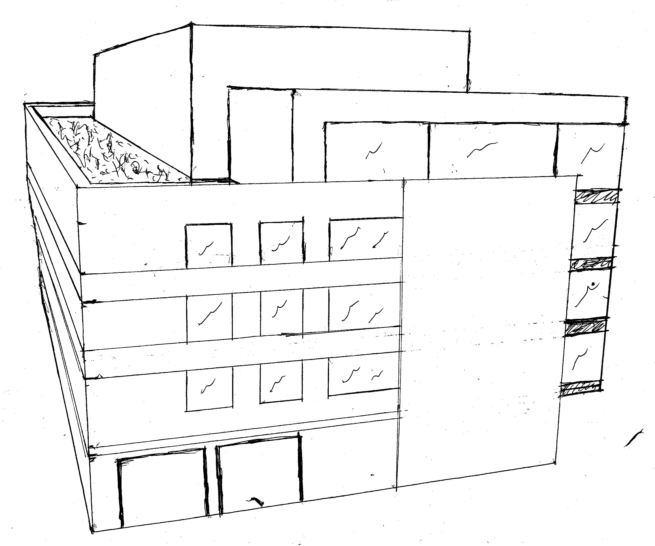
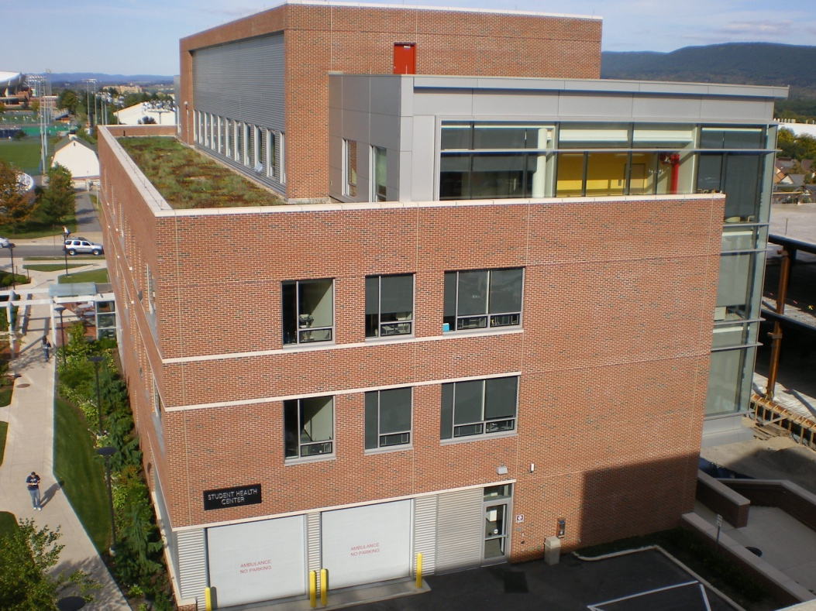
Redesign of the SHC
Redesign of Student Health Center
Post-tensioned floor system
Concrete columns
Shear walls
Foundations
Cost/Schedule impacts
Shading Systems
Questions
Add extra floor w/o increasing building height by decreasing floor thickness

Slide 6
Redesign of the SHC
Redesign of Student Health Center
Post-tensioned floor system
Concrete columns
Shear walls
Foundations
Cost/Schedule impacts
Shading Systems
Questions
PT Floor System:
8” Slab
Typical design strip in x-direction:
(11) - ½” tendons
Typical design strip in y-direction:
(14) – ½“ tendons

Slide 7
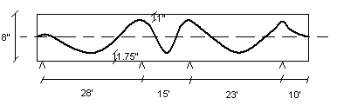
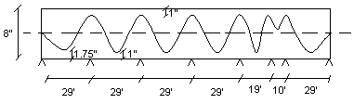
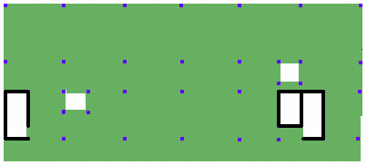
Redesign of the SHC
Redesign of Student Health Center
Post-tensioned floor system
Concrete columns
Shear walls
Foundations
Cost/Schedule impacts
Shading Systems
Questions
PT Floor System:

Slide 8
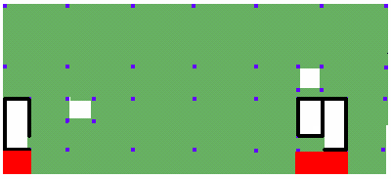
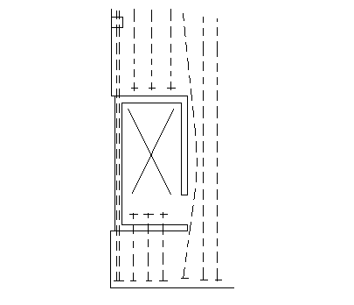
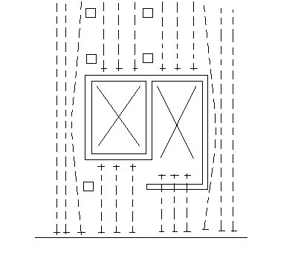
Redesign of the SHC
Redesign of Student Health Center
Post-tensioned floor system
Concrete columns
Shear walls
Foundations
Cost/Schedule impacts
Shading Systems
Questions
Problem Areas
- Openings > 4 ft
- Along cantilever

Slide 9
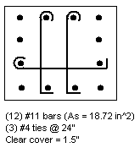
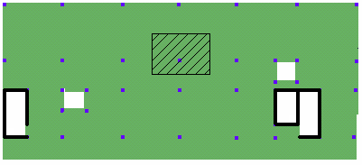
Redesign of the SHC
Redesign of Student Health Center
Post-tensioned floor system
Concrete columns
Shear walls
Foundations
Cost/Schedule impacts
Shading Systems
Questions
Columns:
- Sizes based off first level, worst case (1065 k)
- 18” x 18” throughout

Slide 10
Redesign of the SHC
Redesign of Student Health Center
Post-tensioned floor system
Concrete columns
Shear walls
Foundations
Cost/Schedule impacts
Shading Systems
Questions
Shear Walls:
- Placement (Open Plan)
- Strength and Drift Considerations

Slide 11
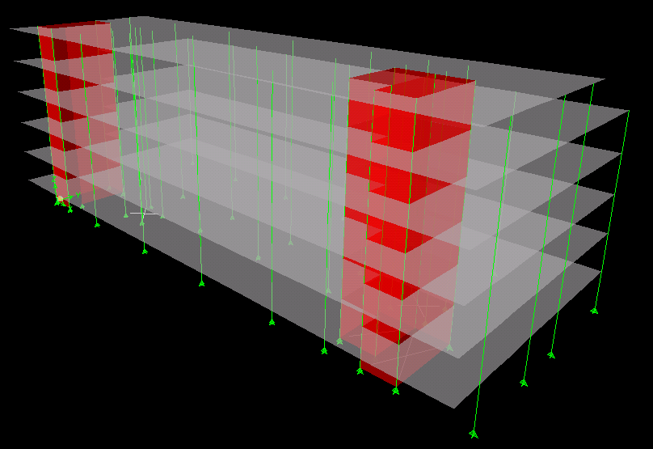
Redesign of the SHC
Redesign of Student Health Center
Post-tensioned floor system
Concrete columns
Shear walls
Foundations
Cost/Schedule impacts
Shading Systems
Questions
Shear Walls:

Slide 12
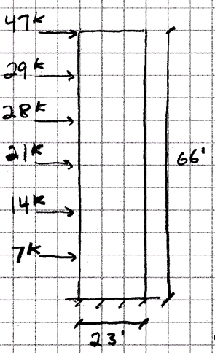
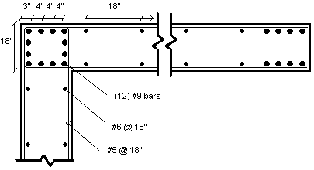
Redesign of the SHC
Redesign of Student Health Center
Post-tensioned floor system
Concrete columns
Shear walls
Foundations
Cost/Schedule impacts
Shading Systems
Questions
Shear Walls:

Slide 13
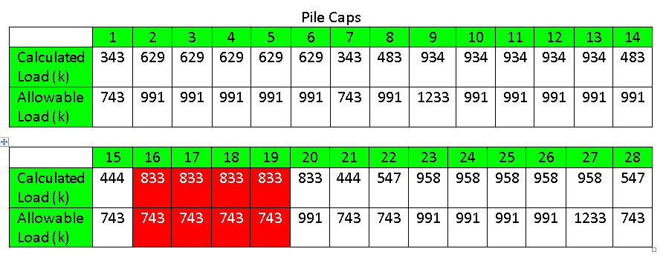
Redesign of the SHC
Redesign of Student Health Center
Post-tensioned floor system
Concrete columns
Shear walls
Foundations
Cost/Schedule impacts
Shading Systems
Questions
Foundation:
Building weight from 8,222 kips to 11,392 kips

Slide 14
Redesign of the SHC
Redesign of Student Health Center
Post-tensioned floor system
Concrete columns
Shear walls
Foundations
Cost/Schedule impacts
Shading Systems
Questions
Foundation:
Changed to 4-pile pile caps instead of 3

Slide 15
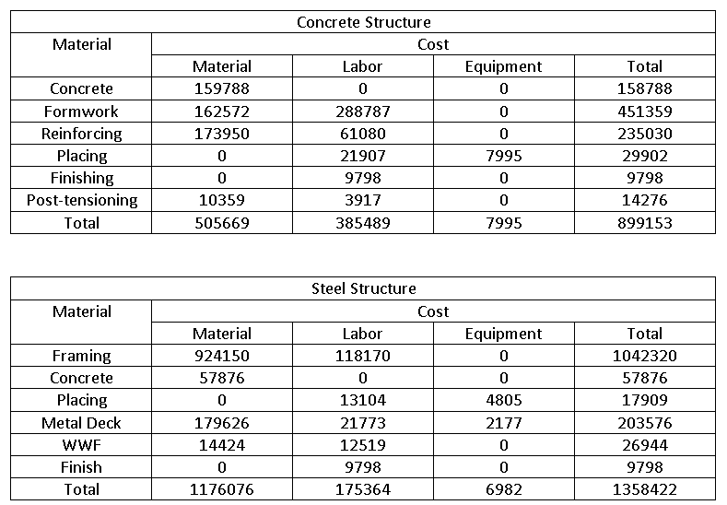
Cost / Schedule Impacts
Redesign of Student Health Center
Post-tensioned floor system
Concrete columns
Shear walls
Foundations
Cost/Schedule impacts
Shading Systems
Questions
Cost Comparison:

Slide 16
Cost / Schedule Impacts
Redesign of Student Health Center
Post-tensioned floor system
Concrete columns
Shear walls
Foundations
Cost/Schedule impacts
Shading Systems
Questions
Cost Comparison:
Didn’t take into account:
Contractors Available
Additional Floor Work
Additional Piles
Mechanical/Electrical Usage

Slide 17
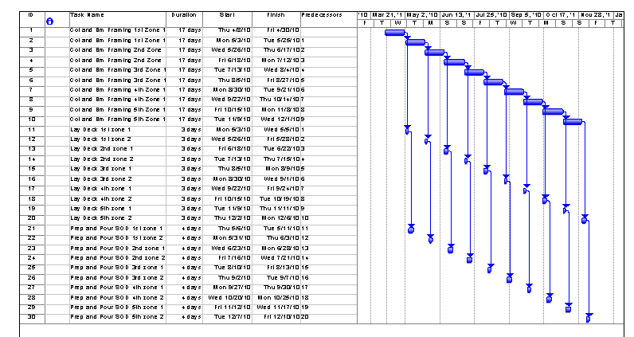
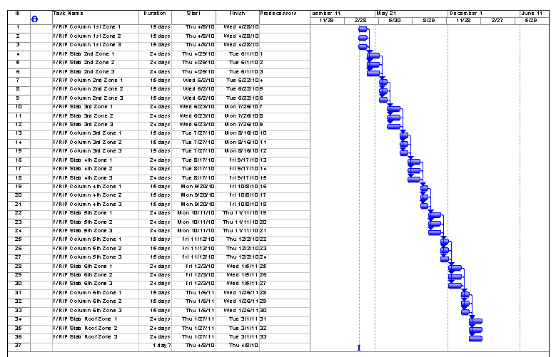
Cost / Schedule Impacts
Redesign of Student Health Center
Post-tensioned floor system
Concrete columns
Shear walls
Foundations
Cost/Schedule impacts
Shading Systems
Questions
Schedule Comparison:
Steel Structure: 177 days
Conc. Structure: 234 days
Didn’t take into account:
Lead Time
Additional Floor Work
Additional Piles
Connections

Slide 18
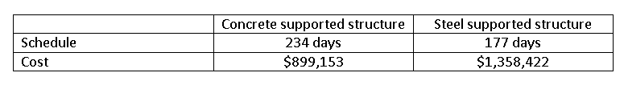
Cost / Schedule Impacts
Redesign of Student Health Center
Post-tensioned floor system
Concrete columns
Shear walls
Foundations
Cost/Schedule impacts
Shading Systems
Questions
CM Conclusion:
Concrete structure costs less
Steel structure is a quicker build
More analysis is needed

Slide 19
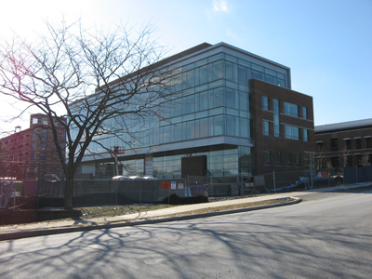
Shading Systems
Redesign of Student Health Center
Post-tensioned floor system
Concrete columns
Shear walls
Foundations
Cost/Schedule impacts
Shading Systems
Questions
Problems with current fabric shades
Architectural Impacts
Possible energy savings
Two systems studied:
Louvers
Light Shelves

Slide 20
Shading Systems
Redesign of Student Health Center
Post-tensioned floor system
Concrete columns
Shear walls
Foundations
Cost/Schedule impacts
Shading Systems
Questions
Louvers:
Fit in with nearby architecture
Economical
Easily Installed

Slide 21
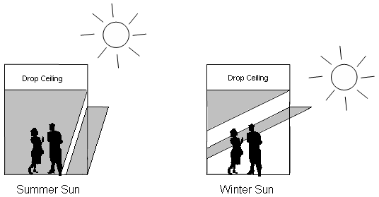
Shading Systems
Redesign of Student Health Center
Post-tensioned floor system
Concrete columns
Shear walls
Foundations
Cost/Schedule impacts
Shading Systems
Questions
Louvers:
10 ft ceiling
30” projection

Slide 22
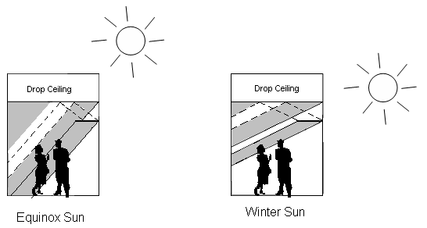
Shading Systems
Redesign of Student Health Center
Post-tensioned floor system
Concrete columns
Shear walls
Foundations
Cost/Schedule impacts
Shading Systems
Questions
Light Shelves:
Energy Savings
Better atmosphere

Slide 23
Shading Systems
Redesign of Student Health Center
Post-tensioned floor system
Concrete columns
Shear walls
Foundations
Cost/Schedule impacts
Shading Systems
Questions
Light Shelves:
Energy Savings :
# of light bulbs in corridor = 100
KWh used per year = 9,344
Electricity Cost (@ $0.10 per KWh) = $934.40
Savings with light shelves = $150

Slide 24
Shading Systems
Redesign of Student Health Center
Post-tensioned floor system
Concrete columns
Shear walls
Foundations
Cost/Schedule impacts
Shading Systems
Questions
Conclusion:
Dual System

Slide 25
Thesis Conclusions
Redesign of Student Health Center
Post-tensioned floor system
Concrete columns
Shear walls
Foundations
Cost/Schedule impacts
Shading Systems
Questions
New concrete building appears to work well and be more cost effective than steel
Downside in schedule
Have to look into program that needs space
Learned the ins and outs of two computer programs
Shading systems viable to reduce need for fabric shading

Slide 26
Questions?
Redesign of Student Health Center
Post-tensioned floor system
Concrete columns
Shear walls
Foundations
Cost/Schedule impacts
Shading Systems
Questions
I would like to thank the following people for their assistance with this thesis project:
My family and friends for their encouragement;
OPP for answering my many questions;
AE faculty for continued help throughout;
Outside consultants for clarification;
Fellow AE students

